Slide 1
DISARM Milestone 3
Debris In Space Autonomous Removal Mechanism
12/4/2020
Notes:
Lets get it

Slide 2
Content
PROJECT INTRODUCTION
CONTROL FLOW
SENSORS
NEW DEBRIS MODELS
CURRENT SYSTEM DIAGRAM
RESULTING SIMULATION
NEXT STEPS

Slide 3
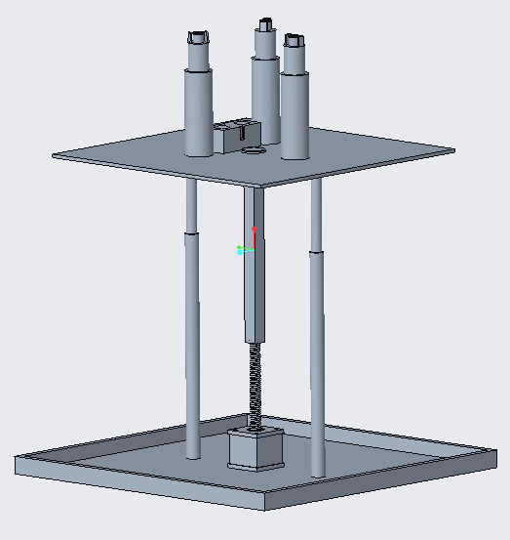
What is DISARM?
An single-use, autonomous, and universal space debris grappling device that uses capacitor discharge stud welding as its method of attachment.
Model of the DISARM design.
Notes:
Don't forget the motivation.

Slide 4
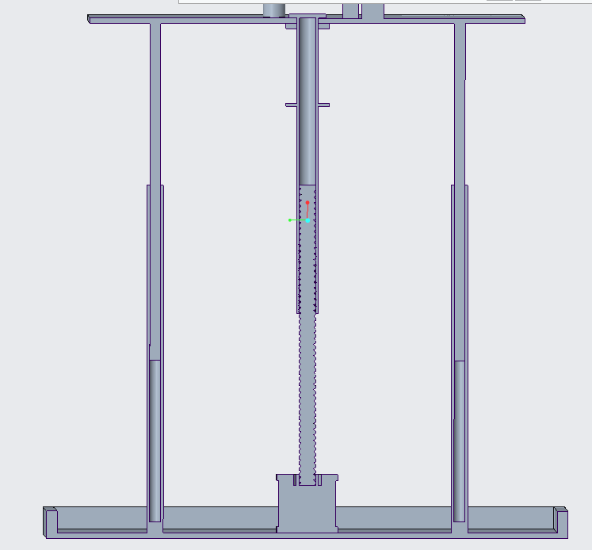
DISARM is designed to be able to grapple a 27U cubesat sized (54kg) orbital debris
Our prototype design will prove the feasibility of capacitor discharge stud welding for space debris removal
Our prototype is not a fully-fledged satellite, but rather an attachment system for a pre-existing one

Slide 5
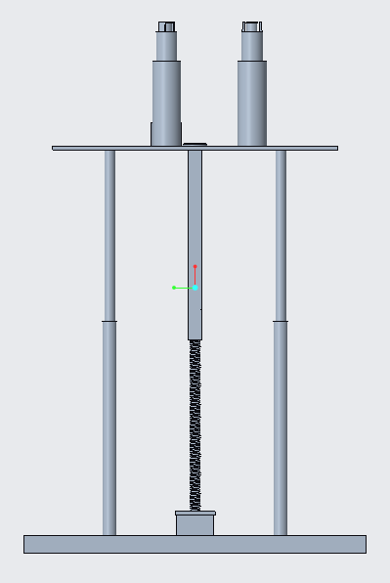
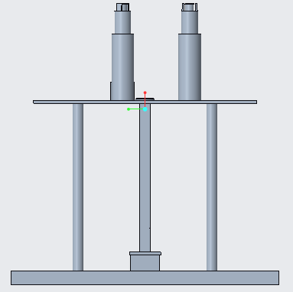
DISARM Prototype Operation
Debris
Debris
Debris
Parent Satellite
Parent Satellite
Parent Satellite
DISARM Fully Retracted
DISARM Fully Extended
DISARM Fully Retracted

Slide 6

MISSION CONTROL FLOW
Groove
Direction
Qualification
Dislocation
Feedback
Calculation
START
Attitude Revision
NO
safe welding location detected
NO
Confirm Successful Completion of Weld
Weld Completion Testing
Begin Stud Welding
YES
YES
STOP

Slide 7
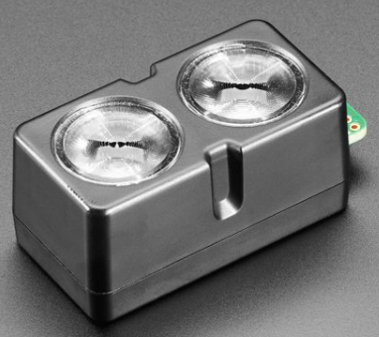
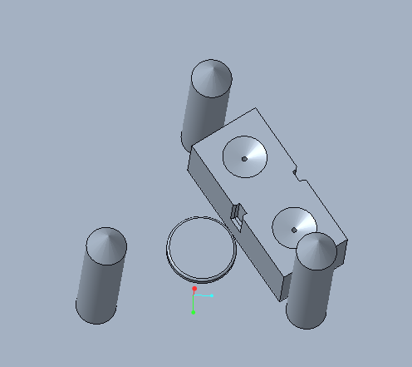
Sensor
Lidar-Lite LED V4
Lidar-Lite LED V4 | Properties
Unit Size (H x W x D) | 52.2 x 21.2 x 24.0 mm
Weight | 14.6 g
Accuracy | ±1cm to 2m, ± 2cm to 4m,± 5cm to 10m
Range | 5 cm -10 m
Interface | I2C or ANT
Power | 4.75-5.25 V
Price | $59.95

Slide 8
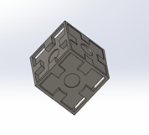
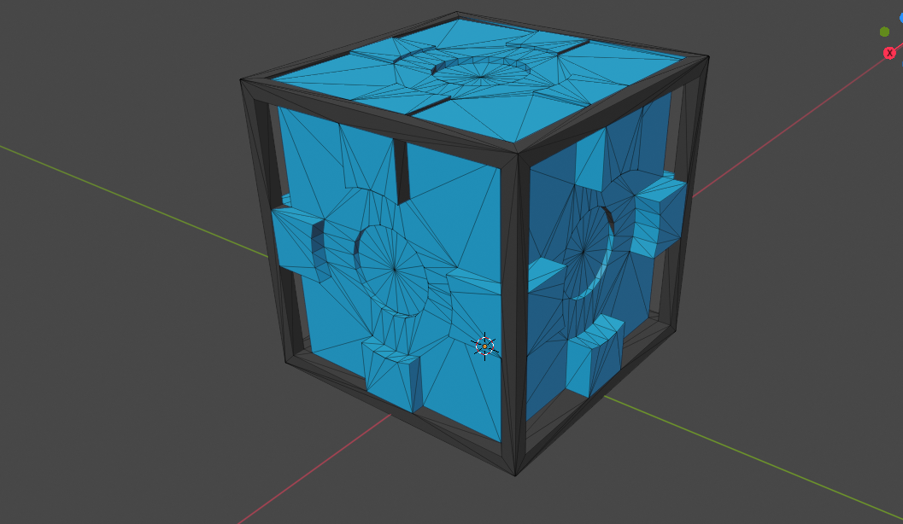
New Test Debris Models
Cubesat Model | 1 Unit | 6 Unit | 27 Unit
Dimensions(cm) | 10 x 10 x 10 | 12 x 24 x 36 | 34 x 35 x 36
Extrusion Depths(cm) | 1.5 | 2.5 | 10.5
Extrusion Radius(cm) | 0.1 | 1.0 | 2.7

Slide 9
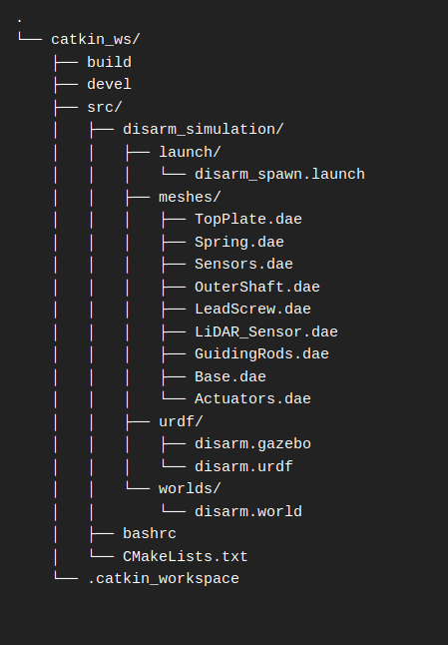
Current System Diagram

Slide 10
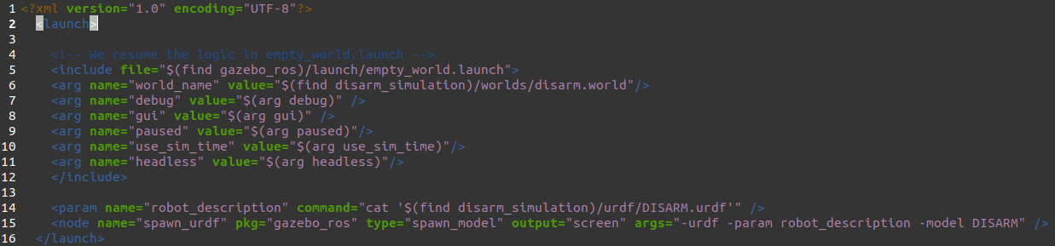
disarm_spawn.launch

Slide 11
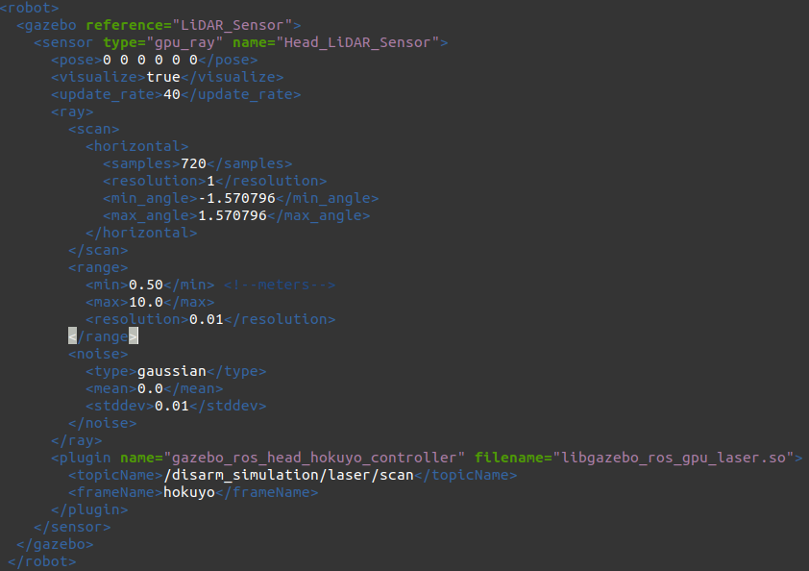
disarm.gazebo

Slide 12
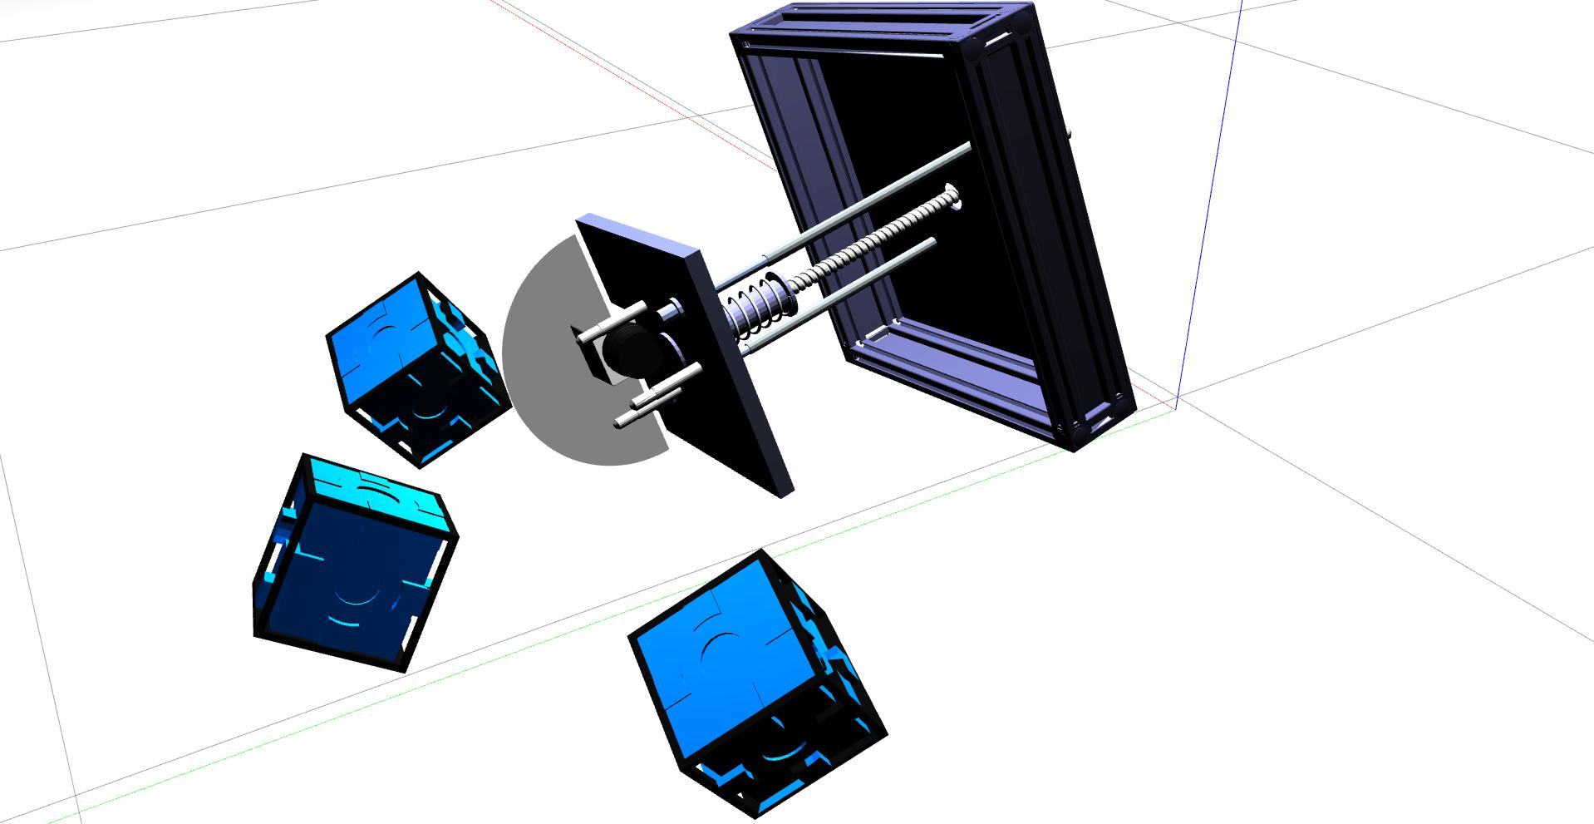
Result Simulation Launch

Slide 13

Next Steps
Fix sensor range not working properly
Complete rest of simulation requirements, demonstrating DISARM welding unto test debris before next semester
Apply simulation code unto real-world devices upon purhcase
Notes:
Need to consolidate this text

Slide 14
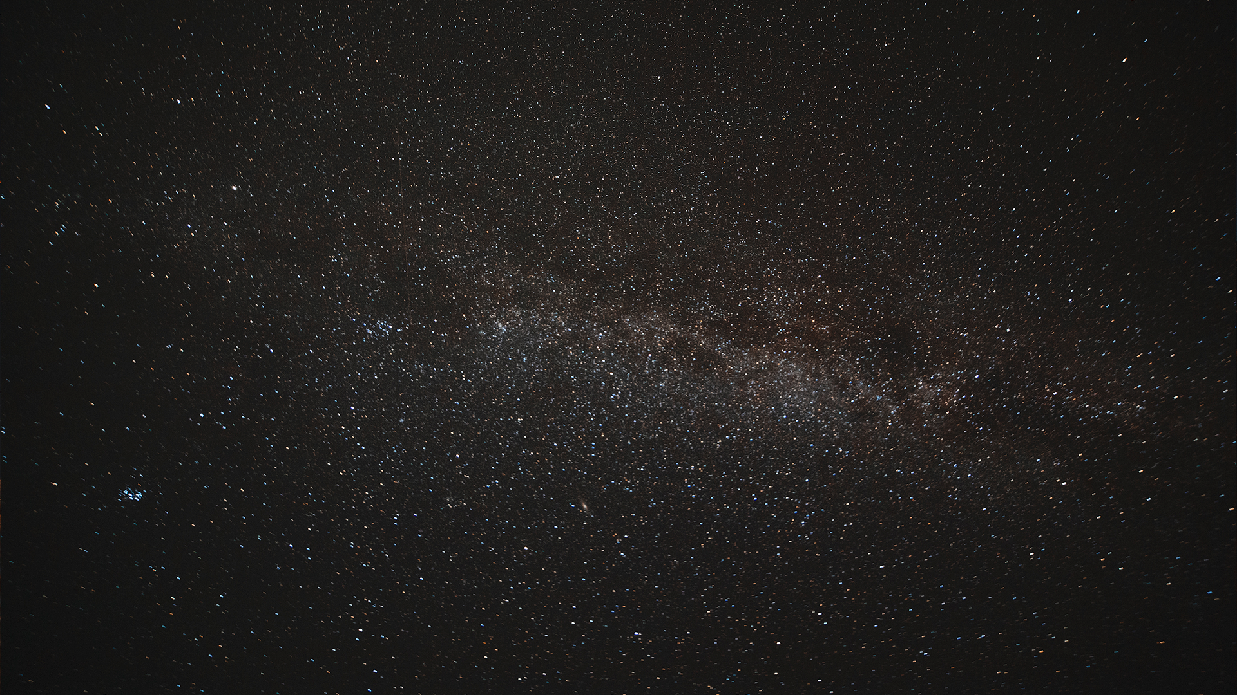
THANK YOU!
Any Questions?
Kyle Watkins, Project Manager
watkinsk2017@my.fit.edu
Luca Rizza, Systems Engineer
lrizza2017@my.fit.edu
Laura Guziczek, Engineer
lguziczek2018@my.fit.edu
Michael Leard, Engineer
mleard2017@my.fit.edu
Ali Lebbar, Engineer
alebbar2016@my.fit.edu
Davey Renoid, Engineer
drenoid2016@my.fit.edu
Matthew Intriago, Computer Science
mintriago2017@my.fit.edu
Vincent Panichelli, Engineer
vpanichelli2017@my.fit.edu
Daniel Soto, Engineer
dsotoperezco2017@my.fit.edu
Nouraldean El-Chariti, Engineer
nelchariti2017@my.fit.edu

